Slide 1
UAE
Foreign direct investment incentives
Markus Susilo
17 April 2019

Slide 2
Content
Trade Relationship – UAE & Turkey
FDI Incentives – UAE Onshore & Free Zones
Alternative Charges to Taxes
Other FDI Attraction Factors
Information about Crowe

Slide 3
Trade Relationship
UAE & Turkey

Slide 4
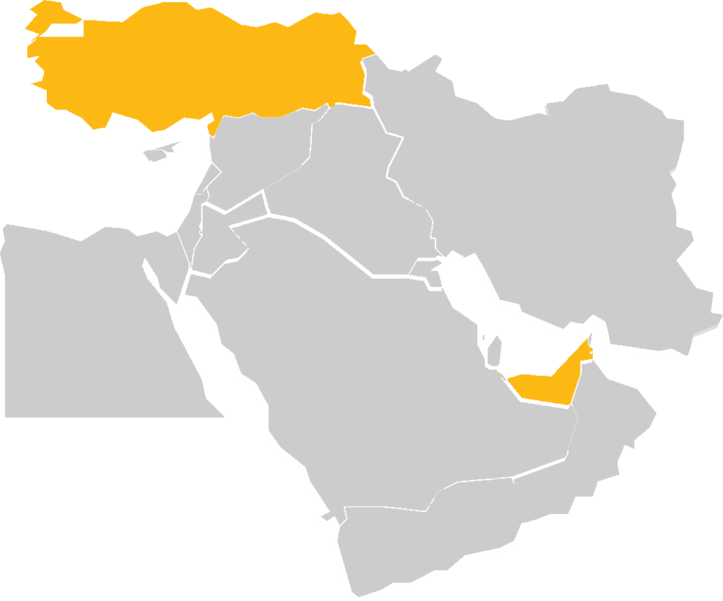
Trade Relationship UAE & Turkey
Agreement concerning the reciprocal promotion and protection of investment
Trade Relationship
UAE & Turkey
UAE data indicate that Turkey was the second largest destination for the UAE’s non-oil exports in 2017 in value terms, accounting for about 9%.
90%
Regular exchanges of trade missions between the UAE and Turkey (until 2018)
The main exports from UAE to Turkey are precious metals and stones, accounting for about 90% of non-oil exports in 2017, and to a much lesser degree, aluminium and plastics.
Turkey remains a key destination for UAE non-oil exports, with IMF data showing that the UAE was the 13th largest source of imports into Turkey in 2017.
© 2019 Crowe

Slide 5
FDI Incentives – UAE Onshore
& Free Zones

Slide 6


UAE for FDI
Onshore or Federal Jurisdictions
7 Emirates: Abu Dhabi, Dubai, Sharjah, Ajman, Ras al Khaimah, Fujairah, & Umm al Quwain.
By default: Federal laws and regulations are applicable
Taxes
  In General: No tax holiday provision
N/A
5%
5%
  CIT:
  There are tax laws for
  Dubai and Abu Dhabi Emirates. However, they are applicable for foreign oil companies and
  foreign banks’ branches
  PIT & WHT:
  N/A
  Excise Tax:
  Tobacco products,
  Carbonated drinks
  (note that this excludes sparkling water),
  & Energy drinks
  VAT:
  5% on goods
  and services
  Custom Duty:
  5% - Part of
  GCC Customs Union
© 2019 Crowe

Slide 7
UAE for FDI
Onshore or Federal Jurisdictions
UAE Tax residency for DTA purposes: | Yes
Repatriation of profit to foreign shareholder: | No restriction applicable
Ownership: | Most activities require companies with majority local UAE shareholders (51%)
Commercial limitation: | Allowed to deal with all customers in the UAE and business has to be conducted in the Emirate where the company is registered, except in the free zone area
Statutory Social Security: | Applicable for local UAE and GCC employees (minority population)
 | Private approved health insurance: Applicable for non UAE and GCC employees (majority population) – only in Dubai and Abu Dhabi
© 2019 Crowe

Slide 8
UAE for FDI
Free Zone Jurisdictions
At least 1 free zone per Emirate and majority of the zones are in Dubai (30+)
By default: Laws and Regulations set by the Free Zone Authority
Taxes
  In General: Tax Holiday for Corporate Taxes
  PIT & WHT: N/A
  VAT / Excise Tax / Custom Duty
Goods:
    Services:
    In general →
    as per onshore jurisdictions
    Designated Zones:
    not subject to VAT and Excise Tax → not subject to customs duty (in most cases)
    Non-designated
    zones:
    as per onshore jurisdictions
© 2019 Crowe

Slide 9
UAE for FDI
Free Zone Jurisdictions
UAE Tax residency for DTA purposes: | Yes
Repatriation of profit to foreign shareholder: | No restriction applicable
Ownership: | Most activities allow companies to have 100% foreign shareholding
Commercial limitation: | Not allowed to sell directly to the local onshore market and business has to be conducted in the free zone whether the company is registered
Statutory Social Security: | Applicable for local UAE and GCC employees (minority population)
 | Private approved health insurance: Applicable for non UAE and GCC employees (majority population) – only in Dubai and Abu Dhabi
© 2019 Crowe

Slide 10
Alternative Charges to Taxes

Slide 11
Alternative Charges to Taxes
UAE has been tax free for both private individuals and corporates until 31 December 2017
Fees as source of income for the UAE Governments (Onshore and Free Zones)
  Annual license fees and some are linked to the annual rent value
  Visa and work permit which are renewable every 2 to 3 years. UAE population consist of non UAE nationals as the majority.
  Office space rent for most free zone companies
Common Fees for
Corporates:
Common Fees for
private individuals:
  Annual license fees and some are linked to the annual rent value
  Visa and work permit which are renewable every 2 to 3 years. UAE population consist of non UAE nationals as the majority.
  Office space rent for most free zone companies
  Visa for dependents
  Housing fees linked
  to annual rent value
© 2019 Crowe

Slide 12
Other FDI Attraction Factors

Slide 13
Other FDI Attraction Factors
Typical cases where MNCs are using the UAE for the offered tax incentives:
  Application of DTA whilst owning the entity 100%
  Designated zones as re-exporting or distribution channel
  Regional management team in the UAE → absence of PIT and no restriction for foreign nationals quota
Legal infrastructures:
  Transparent rules and regulations → based on global best practice
  Most rules and regulations are in Arabic and English
  DIFC courts which are based on DIFC Law (common law jurisdiction) and hear cases in English language
Government support:
  Innovative industry
  Competitive packages in establishing entities for SMEs
  One-stop-solution for company’s compliance requirement in some free zones

Slide 14
Expected Future Development in Further Boosting FDI

Slide 15

Foreseen changes
    FDI laws (more flexibility to FDI).
    Decree Law 19/2018 - Positive list sectors for 100% foreign ownership expected (artificial intelligence, technology, space and renewable energy).
Notes:
“Goods” are all types of tangible property, whether movable or immovable, Water and all forms of energy

Slide 16
Taxation forecast
    No Personal Income Tax expected and
    no plans to raise VAT or excise tax
    No study for increasing Income Tax
    Studies for Corporate Taxation
Notes:
“Goods” are all types of tangible property, whether movable or immovable, Water and all forms of energy

Slide 17
Who we are

Slide 18







Crowe By the Numbers
764
offices
8
ranked as the eighth largest global accounting network*
26,447
professionals
^{th}
USD3.7B
global revenue
9%
growth
5,020
administrative staff
3,860 partners
129
countries
35,327
partners and professionals
© 2019 Crowe
*IAB Survey: World Leading accounting networks 2016: fee data

Slide 19
Crowe UAE
6
1981
^{th}
largest accounting
and advisory services
firms in the UAE
Established in 1981
250+ partners and professionals
16 offices
© 2019 Crowe

Slide 20
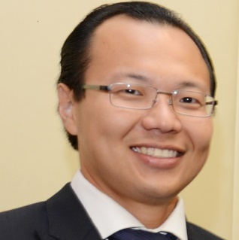
Global Audit – International Director Profile
Experience
Markus has over 14 years of professional experience in the financial services industry in the UAE, other GCC countries and Western Europe. He has supported various SMEs and multinational corporations to establish, restructure and manage the financial and legal compliance of their presence locally.
Over the years, multinational companies in the UAE and Austria have appointed him as a member of their board of directors and company secretary.
He has effectively implemented multi-jurisdictional payroll projects in the GCC of up to 1000+ employees.
In the field of accounting and taxation, he has coordinated multi-jurisdiction tax compliance and tax structuring projects as well as statutory accounting.
As a fluent German speaker, he has launched the German Desk of Crowe Horwath in the UAE catering to the significant demand of the German-speaking community.
Professional Affiliations
Trusted auditor, tax and business advisor of the Commercial Section of the Austrian Embassy in the UAE.
Professional Summary
Markus Susilo is a Partner at Crowe Horwath UAE. He is responsible for the consulting office in Dubai Multi Commodity Center and specializes in Business Process Outsourcing activities for Multi-National Companies in the UAE both in Free Zones and Onshore.
With the inception of VAT in the UAE, Markus has been appointed as VAT Service Team Leader – UAE in 2017.
Client & Industry Focus
Oil & Gas
Real Estate
IT
Banking
Healthcare
Markus Susilo
Partner
Crowe Mak Consulting DMCC
Office 407&607, Gold Crest Executive Tower
Jumeirah Lake Tower
PO Box 336309, Dubai
United Arab Emirates
Main Phone
+971 4 220 0198
E-mail
markus.susilo@crowe.ae
Education
Mag. (FH) from IMC University of Applied Sciences, Austria
BEc from InHolland University, The Netherlands
© 2019 Crowe

Slide 21
For more information, contact:
Markus Susilo
Partner
Office: +971 4 325 9900
Mobile: +971 50 656 7874
E-mail: markus.susilo@crowe.ae
© 2019 Crowe

