Slide 1
R&D Incentives: the Dutch Example
Sigrid Hemels
Istanbul, 17 April 2019

Slide 2
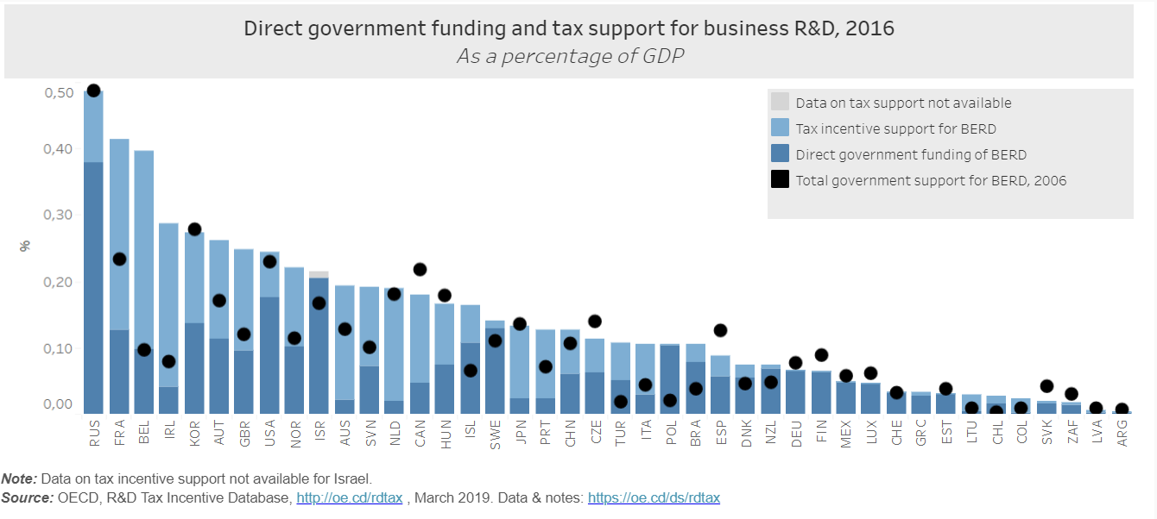
Tax incentives most important means for government support to R&D in NL

Slide 3
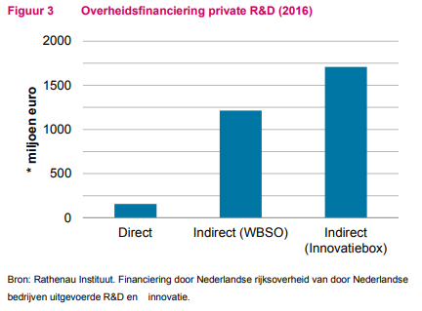
Two Dutch R&D tax incentives
R&D tax credit (WBSO): reduction of wage tax
Innovation box: reduction of corporate income tax
Aim:
Make the Netherlands attractive for innovative companies to attract and keep high quality employment
To promote R&D activities in the Netherlands
Underlying objective: increase economic growth
https://www.cpb.nl/sites/default/files/omnidownload/CPB-Policy-Brief-2018-13-Digitalisering-R-en-D.pdf
Notes:
Naar omvang zijn de WBSO en de Innovatiebox de belangrijkste subsidies voor private R&D in Nederland. De WBSO geeft bedrijven een subsidie op de loonkosten van R&Dmedewerkers en andere R&D-kosten. Via de WBSO ontvingen Nederlandse bedrijven in 2016 een belastingkorting van 1,2 miljard euro (figuur 3). De Innovatiebox geeft een belastingvoordeel door bedrijfswinsten uit innovatieve activiteiten tegen een lager tarief te belasten. Dit leverde bedrijven in 2016 een geschatte belastingkorting op van 1,7 miljard euro. Ter vergelijking: de directe financiering van private R&D door de Nederlandse overheid bedroeg 156 miljoen euro.

Slide 4
R&D tax credit
For R&D activities by employees on the payroll of the company
Obligation to pay out withheld wage tax to the tax administration is reduced
32% tax credit (up to 40% for startups) of the first €350,000 in R&D costs (labor, machinery & equipment, intangibles, buildings) and 16% for those costs and investments exceeding €350,000.
Only for R&D projects that entail:
the development of technically new (components of) physical products, physical production processes, or software; or
technical scientific research.
Beforehand an R&D statement must be obtained for a specific amount of expenses: tax credit cannot be more than the amount in the statement

Slide 5
Innovation box
Included in the corporate income tax (CIT) → not for individuals
Regular CIT rate for profits over € 200,000: 25% (below: 19%)
Effective rate of 7% in respect of income (including royalties) in relation to certain qualifying intangible assets: only 7/25 (28%) of such income included in tax base→ reduction of tax base to allow for regular loss compensation.
Regime only applies insofar as total income from the intangible assets exceeds the total costs for these assets
For SMEs: all intangibles for which they have an R&D statement.
Others: R&D-statement plus listed intangible (examples: software, patent, plant variety right, license to distribute medication).
Benefits are reduced if R&D activities are outsourced to related parties (nexus approach).

Slide 6
Nexus approach: BEPS Action 5
Starting point: R&D regimes designed to encourage R&D activities and foster growth and employment
ensure that taxpayers engage in substantial R&D activities and incur actual expenditures on such activities
Nexus approach: tax payer can only benefit from an R&D regime to the extent that the taxpayer itself incurred qualifying R&D expenditures that gave rise to the income
Expenditure as a proxy for activity
Lindenberg Schoueri (2018): conflicts with trade and investment law

Slide 7
Dutch evaluation of the innovation box
2015: external commercial bureau (paid by government) evaluated the years 2010-2012
Innovation box is effective and efficient
Contributes to keeping and attracting R&D activities and high quality employment
Increased competition as other countries have introduced similar incentives
A country without an innovation box lags behind → prisoners dilemma….
Innovation box increases R&D activities in the Netherlands
However, not the most powerful tool to promote R&D and innovation: no guarantee that the CIT benefit is actually used for R&D and innovation.

Slide 8
Evaluation: costs of the innovation box
For each euro lost in tax income EUR 0.54 additional R&D expenses (‘Bang-for-the-Buck’).
Because of increased use of the innovation box increased costs for the government: 2008: EUR 52 mln, 2010 EUR 361 mln, 2012 EUR 742 mln.
Innovation box might lead to more CIT income because existing companies start with R&D activities and new companies come to the Netherlands, but the amount of this additional income is unknown.
80% of the benefit of the innovation box is enjoyed by big companies that account for 59% of the spending on R&D
Revenue loss increased further:
https://www.binnenlandsbestuur.nl/Uploads/2018/9/Miljoenennota-2019-bijlage.pdf
Year | 2014 | 2015 | 2016 | 2017 | 2018 | 2019 | Average % growth 14-19
Revenue loss (mln euro) | 1,081 | 1,265 | 1,368 | 1,554 | 1,502 | 1,562 | 7.6%

Slide 9
Evaluation and costs of R&D tax credit
Evaluation in 2012 (years 2006-2010) and 2019 (2011-2017).
2012: R&D tax credit promotes private wage expenses for R&D
2012 Bang-for-the-Buck: for each euro lost in tax income EUR 1.77 additional R&D wage expenses. 2019: decreased to 0.9.
2012 Deadweigh loss/windfall gain (amount of wage that would have been incurred without the R&D tax incentive) 55%. For small companies: 31%, for big companies (R&D wage costs of 75 mln): 65%. 2019: average deadweigh loss increased to 75%.
Efficient?
Deadweigh loss not calculated in evaluation of innovation box
Notes:
https://www.rijksoverheid.nl/documenten/kamerstukken/2018/09/18/kamerbrief-over-de-wbso-in-2019

Slide 10
Evaluation and costs of R&D tax credit
2012: 67%/ 2019 63% of the benefit goes to small and medium sized enterprises (SMEs). SMEs responsible for 43% of all R&D expenses. 2019: 40%.
2019: 1% of all companies make use of R&D tax credit
2019: 6% of companies that use R&D tax credit also make use of innovation box
Innovation box costs more than R&D tax credit
Year | 2014 | 2015 | 2016 | 2017 | 2018 | 2019 | Average % growth 14-19
Revenue loss (mln euro) | 780 | 769 | 1,208 | 1,182 | 1,163 | 1,205 | 9.1%
https://www.binnenlandsbestuur.nl/Uploads/2018/9/Miljoenennota-2019-bijlage.pdf
Notes:
https://www.rijksoverheid.nl/documenten/kamerstukken/2018/09/18/kamerbrief-over-de-wbso-in-2019

Slide 11
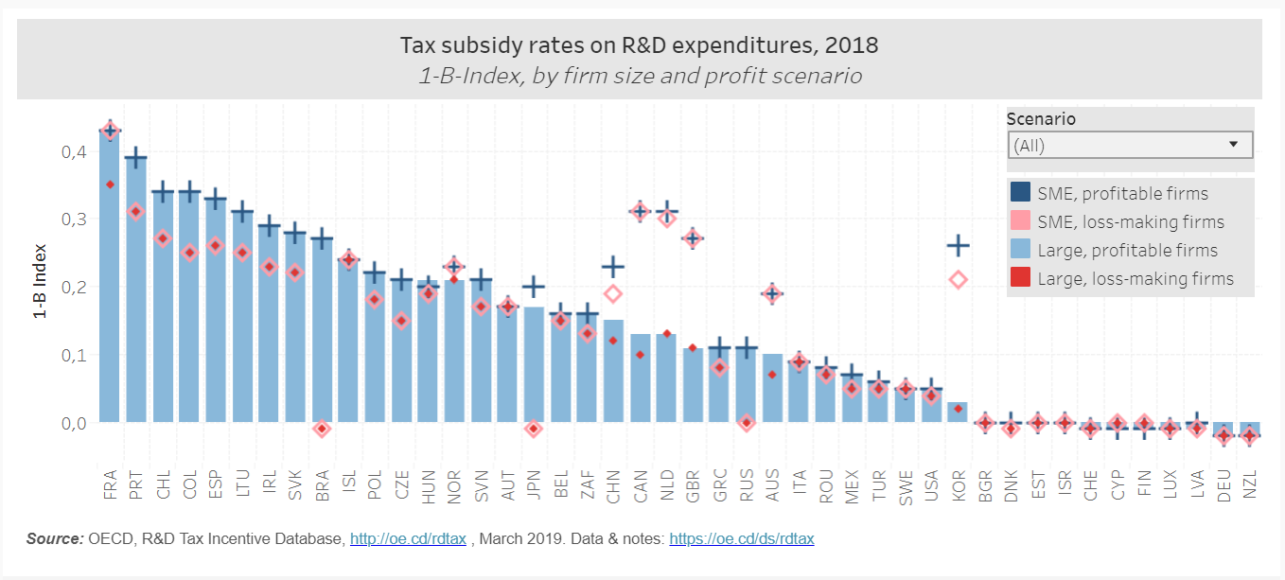
Dutch tax subsidy relatively generous, especially for SMEs
Notes:
The Dutch tax subsidy is 0.3 whereas the OECD average is 0.16 for profitable SMEs and 0.14 for loss making SMEs and the EU average is 0.15 and 0.13 respectively. For large companies the tax subsidy in the Netherlands is 0.15 which is above the OECD average of 0.13 for profit making companies and 0.10 for loss making companies and above the EU average of 0.13 and 0.11 respectively.
The economic benefits of additional R&D as a result of the R&D tax credit have not been compared with the costs of the R&D tax credit: no cost-benefit analysis has been carried out. Nevertheless, it is concluded that if spillover effects are included, it is plausible that the benefits of the R&D tax credit are higher than the costs.
Boer de, P.J et al, Evaluatie WBSO 2011-2017, Ape/UNU-Merit/Dialogic 2019, https://www.rijksoverheid.nl/documenten/rapporten/2019/02/28/evaluatie-wbso-2011-2017 (accessed 13 April 2019), p. 139.

Slide 12
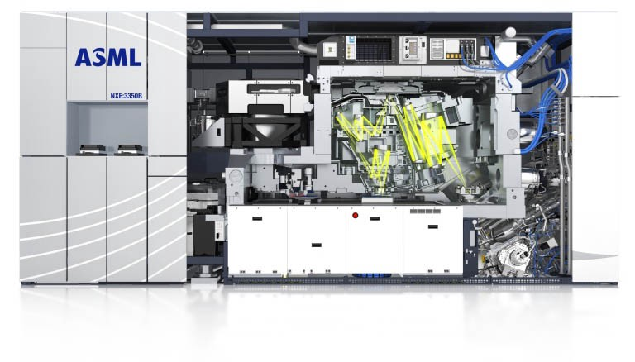
Changes in innovation box both because of evaluation and BEPS Action
Introduction of nexus approach to make sure that innovation box is not used for tax avoidance/evasion
Double entrance ticket for big companies (R&D statement and intangibles must be listed), single entrance ticket for SME’s (R&D Statement suffices)
Reduction of benefit by increasing the effective rate from 5% to 7%
Strong lobby to keep the innovation box

Slide 13
Risks for the government budget
Direct subsidies for R&D are capped
R&D tax credit is capped as well through the R&D statement (2019: EUR 1205 mln)
Innovation box not capped → increased revenue loss because of this open ended subsidy for MNEs:
2019: estimated at 0.2% of GDP
2019: estimated at 6.2% of total CIT revenue (total CIT income: 25.3 billion)

Slide 14
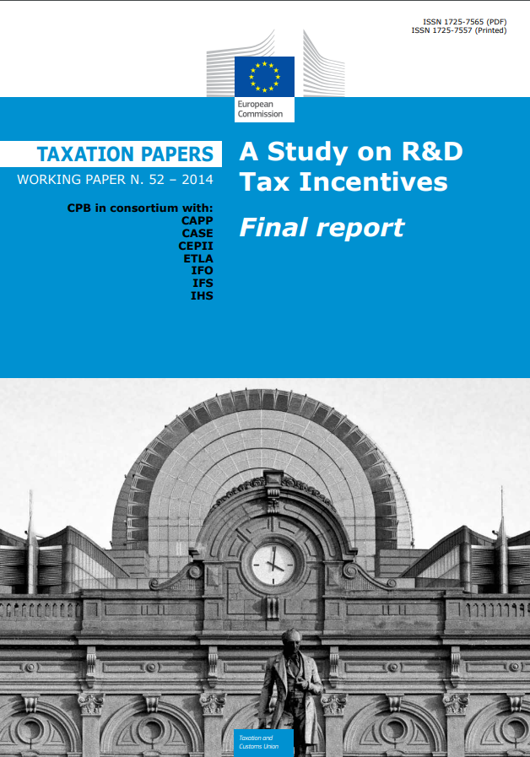
Critique of Dutch Bureau for Economic Policy Analysis (CPB)
Bureau for Economic Policy Analysis (CPB, part of the government) 2014: ”patent boxes introduce a preferential rate for income from innovations that are already protected by Intellectual Property Rights”
Beneficial for MNEs
CPB report December 2018:
R&D tax credit suitable for companies that plan on doing R&D beforehand and do R&D themselves: does not promote working with other companies on open source software, sharing knowledge, outsourcing not allowed
Innovation box incentive for profitable companies with innovations from the past: winner takes it all
Competitive disadvantage for innovative companies and start ups: abolishing innovation box leads to more level playing field
Current incentives not future proof: not fit for the digital era
Notes:
https://www.cpb.nl/sites/default/files/omnidownload/CPB-Policy-Brief-2018-13-Digitalisering-R-en-D.pdf

Slide 15
Conclusion
Substantial revenue loss in the Netherlands because of R&D incentives
Bang-to-the-bucket below 1
Deadweigh loss of R&D tax credit 75% (innovation box: unknown)
Prisoners dilemma: not more R&D, but just a shift to the country with the most attractive incentives? → race to the bottom.
Future proof or just protecting current market players, not leading to sharing knowledge (spill over effects restricted) and actually impeding innovation?

Slide 16
Thank you!
hemels@law.eur.nl

