Slide 1
Tax Incentives: Promises and Pitfalls International Symposium “The Efficiency of Tax Incentives in the World and in Turkey” Istanbul, 17th April 2019 Luisa Dressler Centre for Tax Policy and Administration, OECD

Slide 2
Outline
Introduction
The benchmark system
Advantages and disadvantages of tax incentives
Tax incentive analysis and reporting

Slide 3
Tax incentives – attempt of a definition
Tax expenditures are often defined as targeted tax provisions that provide a favourable deviation from the general tax treatment and that result in a reduced or postponed tax burden for a taxpayer.
Rationales for tax expenditures can be
to incentivise taxpayers to engage in a particular economic activity that the taxpayer might not be willing to undertake under standard tax treatment; → tax incentive
to take into account positive externalities, where an activity has benefits to society that are not captured in market prices, and incentivise the activity; → tax incentive
to provide compensation and address poverty or equity concerns;

Slide 4
Tax expenditures and tax incentives – examples
Some examples:
Accelerated depreciation or initial capital allowances – to encourage investment in a particular sector or region;
Provide reduced corporate income tax rates to SMEs – to boost innovation and knowledge creation or support firms in overcoming financing constraints;
Patent boxes (preferential treatment to corporate income earned from intellectual property) – to boost research and development (R&D) and innovation;
Reduced or zero value-added tax (VAT) rates for specific goods – to alleviate tax burden on low-income households or support specific sectors;
Mortgage interest deduction from personal income taxes (PIT) – to encourage homeownership;
Exempting international aviation from fuel taxes – to enhance connectivity, tourism and trade.

Slide 5
The benchmark system
Tax incentives are often defined by the benchmark tax system from which they derogate.
The benchmark system is highly tax- and country-specific:
A lower tax rate for a particular industry can be viewed as a tax incentive in one country, but as an integral feature of the tax system in another country;
Is the tax provision a structural part of the tax system (benchmark) or a deviation from it (tax incentive)?
At the broadest conceptual level, the benchmark tax system can be defined as the consistent taxation of either income or consumption
E.g. If final consumption by domestic households is taxed, zero VAT rates for exports would be structural, and reduced VAT rates for specific goods seen as an incentive.
E.g. all net income (= revenue less expenses incurred in deriving that income) is taxable in most countries; therefore allowances that offset current expenses are structural, and all untaxed revenue is an incentive.

Slide 6
Advantages of tax incentives …
Tax incentive may be effective and achieve the stated objective
e.g. increase incentives for investment, but one needs to correct for redundancy and displacement
Tax incentives may be efficient, e.g. internalise positive externalities of R&D
Tax incentive may increase tax revenues in the long-term, e.g. if additional investment was generated
Political advantage: tax incentives are less visible than direct spending

Slide 7
… and their disadvantages
Tax incentives can be costly (forgone government revenue), particularly if objective would have been achieved without incentive (redundancy):
Revenue foregone is estimated at ~8% of GDP in the USA in 2017 (Redonda and Neubig, 2018);
Revenue forgone is estimated to represent ~half of total government spending in GBR per year (Miller, 2018);
Limited effectiveness to reach stated objective:
E.g. only few additional investment is generated; incentive subsidises activity that would have taken place anyway;
Limited efficiency of tax incentives :
E.g. unequal treatment of taxpayers, distorted resource allocation, non-neutrality of tax system, incentives to shift taxable income, increases complexity of the system;
Administrative costs and increased compliance burden (both taxpayer and government):
E.g. definition of goods eligible for reduced VAT rates; claiming refunds for reduced fuel taxes;
Tax incentives and associated costs are less transparent, which reduces accountability;
Many studies find: costs of tax incentives > benefits

Slide 8
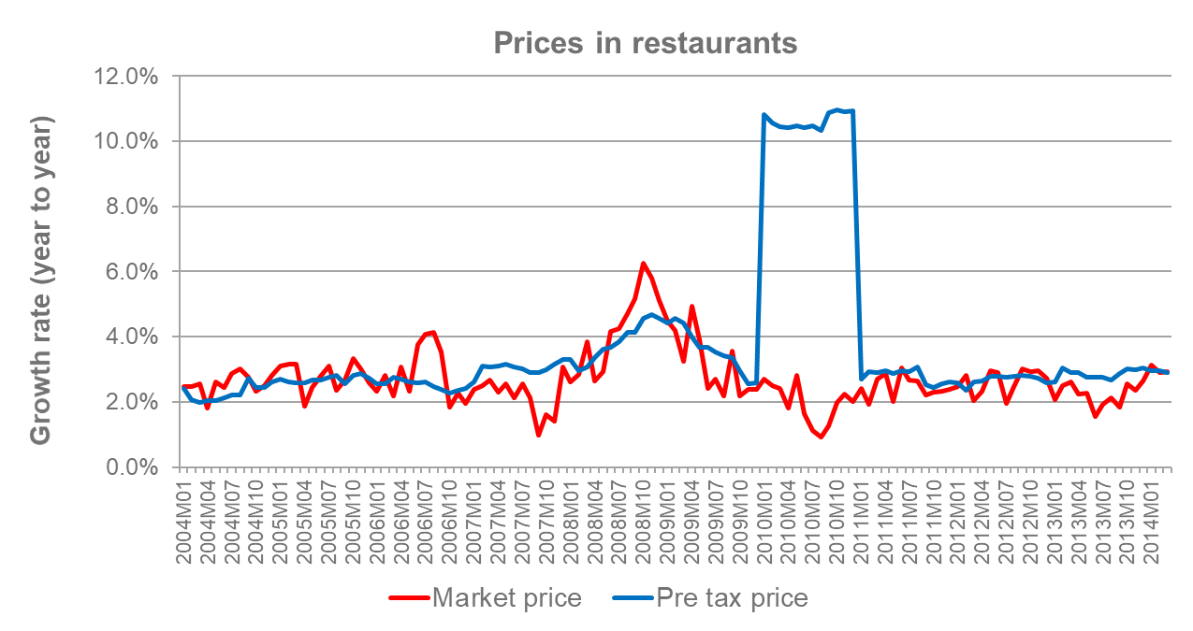
Example 1: Low additionality and pre-tax prices
Tax incentives may be captured in increased pre-tax prices
Example: reduced VAT rate in the restaurant sector in Belgium in 2010;
Objective: increase demand for restaurants and therefore employment in the sector;
Observation: the VAT reduction was not passed through to market prices (imperfect competition) → consumer did not benefit from the reduction;
Pass-through depends on market structure and technology constraints.

Slide 9
Additionality and FDI
Effectiveness of incentive depends on different factors, e.g.
Differentiation in effective tax rates: the higher the tax rebate, the higher the additional effect?
Elasticities of supply and demand: to what extent do investors react to changes in tax?
E.g. investors may come independently of tax treatment (resource-seeking, market-seeking FDI)
E.g. investors may not come, even with strong tax incentives (poor investment climate, low or volatile rate or return)
Impact on pre-tax prices: to what extent does the incentive translate into market prices?
Empirical evidence: benefits of tax incentives are limited, the design of incentives matters
Klemm and Van Parys (IMF WP, 2009): lower corporate tax rates and longer tax holidays attracted FDI in Latin America, but not in Africa in 1985-2004. They are not effective in boosting growth and private capital formation.
Chai and Goyal (IMF WP, 2008): “Forgone tax revenues [from preferential treatment] range between 9.5 and 16 percent of GDP per year [in the Eastern Caribbean, during 1999 and 2003], whereas total FDI does not appear to depend on concessions”.
House and Shapiro (AER, 2008): Accelerated depreciation reduces the user cost of capital (US, 2002 & 2003); elasticity of investment to user costs of capital is estimated between 6 and 14.
Devereux et al. (CBT, 2016): investment is responsive to user cost of capital (UK, 2004).

Slide 10
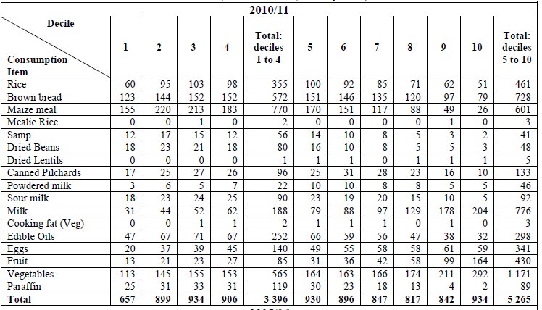
Example 2: Distributional impacts of VAT zero-rating
Zero VAT rates may benefit middle and high income earners
Zero-rating benefit by consumption decile, 2010/11 (Rand million, 2012 prices
Example: VAT zero-rating of goods that are often purchased by low-income households in South Africa;
Objective: mitigate the regressivity of VAT;
Observation: In 2010/2011, the poorest 40% of households received much less benefits from zero-rating than the richer households;
Even if the poor spend a larger proportion of their income on some items, the rich will typically spend more in absolute terms;
Finding: VAT zero-rating is a less effective policy tool to target the poor compared to existing social transfer programmes.
Source: Jansen and Calitz (2017)

Slide 11
Tax incentive analysis and reporting
Once introduced, removing tax incentives is difficult
costs of tax incentives are less visible and transparent compared to direct spending policies;
benefits are highly visible and narrow; asymmetric distribution of winners and losers;
Tax incentive analysis and reporting can create accountability and transparency, e.g. by highlighting revenue costs.
To reform tax incentives, their effectiveness and efficiency needs to be assessed
i.e. which incentive yields stated policy goal without major distortions?
Tax incentive analysis and reporting supports the evaluation of tax incentive effectiveness and efficiency.

Slide 12
Reporting of tax incentives
Tax incentive reports
Are best disclosed as part of the budget and would be established regularly;
Preferably, an expenditure report would indicate for each tax incentive that is provided
If resources are constrained, a less ambitious report would at least
Identify and describe all available incentives, their policy goal and legal reference in a first step;
Aim at quantifying revenue forgone of most significant incentives afterwards.
Name and description of incentive; Stated policy goal; Tax type and benchmark definition; Legal reference; Time limit; | Estimate of revenue forgone (incl. forward looking estimates); Estimation method; Planned or accomplished evaluation (e.g., effectiveness, efficiency, distributional effects, sustainable);

Slide 13
Country examples
Member States of the European Union “shall publish detailed information on the impact of tax expenditures on revenue” (Council Dirctive 2011/85/EU);
Member States of the Union Economique et Monétaire Oues Africaine are asked to provide evaluation of fiscal expenditures and establish periodical reports (Decision No 8/2015/CM/UEMOA);
Recent study shows that only nine out of 43 OECD and G20 countries provide regular and detailed tax expenditure reports (Redonda and Neubig, 2018);

Slide 14
References
Chai and Goyal (2008) “Tax Concessions and Foreign Direct Investment in the Eastern Caribbean Currency Union”, IMF Working Paper, WP/08/257.
Devereux, Xing and Maffini (2016) “The impact of investment incentives: evidence from UK corporation tax returns”, Centre for Business Taxation Working Paper, WP 16/01.
House and Shapiro (2008) “Temporary Investment Tax Incentives: Theory with Evidence from Bonus Depreciation”, American Economic Review, Vol. 98/3, pp. 737-768.
Jansen and Calitz (2017) “Considering the efficacy of value-added tax zero-rating as pro-poor policy: The case of South Africa”, Development Southern Africa, Vol. 34/1, pp. 56-73.
Klemm and Van Parys (2009) “Empirical Evidence on the Effects of Tax Incentives ”, IMF Working Paper, WP/09/136.
Miller, H. (2018) “Tax reliefs: look for the tax design behind the big numbers”, Observation, Institute for Fiscal Studies.
Redonda and Neubig (2018) “Assessing Tax Expenditure Reporting in G20 and OECD Economies”, Discussion Note, 2018/3, Council on Economic Policies.

Slide 15
© OECD 2019 copyright
This presentation should not be reported as representing the official views of the OECD or of its member countries. The opinions expressed and arguments employed are those of the authors.
The OECD freely authorises the use of this material for non-commercial purposes, provided that suitable acknowledgment of the source and copyright owner is given. All requests for commercial uses of this material or for translation rights should be submitted to rights@oecd.org.
Luisa Dressler
Economist Centre for Tax Policy and Administration, OECD
2, rue André Pascal - 75775 Paris Cedex 16 Luisa.Dressler@oecd.org
www.oecd.org/ctp || @OECDtax

